Slide 1
Date: 02 December 2025

Slide 2
Weekly Presentation : Rotor Bearing System
Week number: 10
Date: 02 /12/2025
Supervisor: Prof. Peter Quell
Group members: Divyesh Mistry, Venkata Sreekanth .K , Sreehari Padachery, Jill Sadariya
Presenter : Venkata Sreekanth .K

Slide 3
Agenda
Bearing Housing.
Static Safety Calculation of Bearing.
Lock nut.
Shaft.
Rotor Bearing Assembly.
Force calculation on Bolts
Bibliography.
Venkata Sreekanth .K

Slide 4
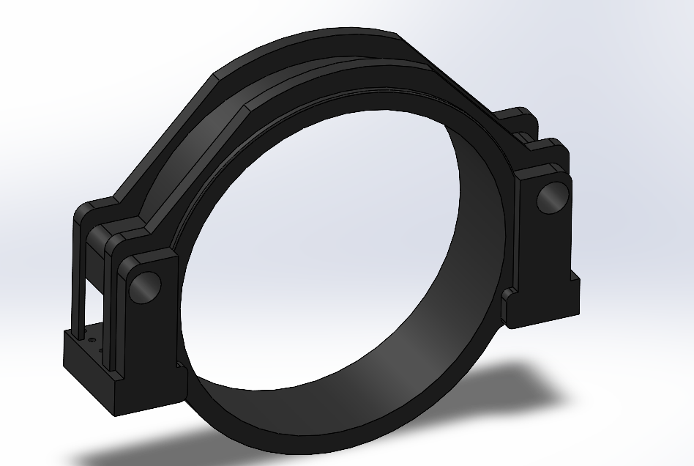
Bearing Housing
parameter | value
OD | 2500mm
Rib radius | 1400mm
ID/Bore dia | 2240mm
Width | 640mm
Total length | 3200mm
Venkata Sreekanth .K

Slide 5
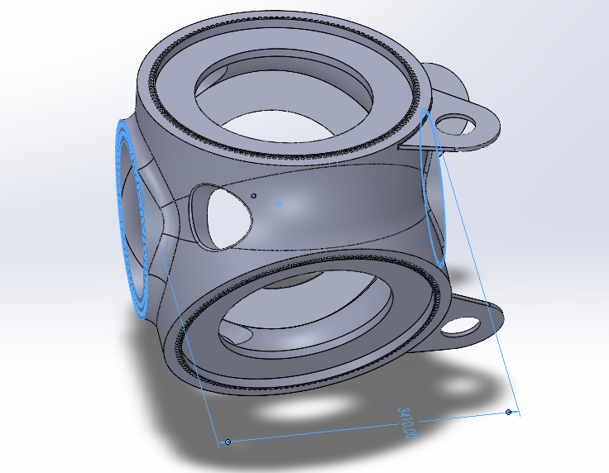
Static Safety Calculation of Bearing (Based on Assumption and scaling up factor)
L1: Distance between hub and bearing A =( half length of bearing + space between flange and bearing housing+ Integrated rotor lock disc flange thickness+ hub center distance)=
L1 = 315mm+300mm+250mm+1705mm = 2570mm
L2: Distance between hub and bearing B= L1+bearing A center to Bearing B center distance = 2570+3000mm
=5570mm
Hub-CoG Shaft Ls= Length of shaft until its Center of Mass + 1705 mm
=929.69mm+ 1705mm
=2634.69mm
Hub- CoG Gearbox Lg = 1600mm(half of gear box width) + 75mm+3000mm+1705mm =6380mm
Source: Optimus Syria ,Rotor Hub
Venkata Sreekanth .K

Slide 6
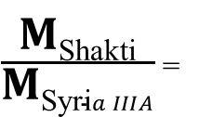
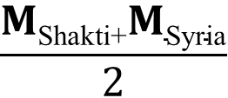
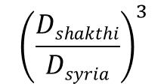
Static Safety Calculation of Bearing (Based on Assumption and scaling up factor)
Scaled up value of inputs from Optimus Shakti , for the forces required for the bearing selection process
Type | Variable | Value | Unit
Moments | M_{XR}​ | 14308.27 | kNm
 | M_{YR}​ | 19001.85 | kNm
 | M_{ZR}​ | -1861.05 | kNm
Reaction | F_{XR}​ | 1404.5 | kN
Forces | F_{YR}​ | 1570.59 | kN
 | F_{ZR}​ | 1566.97 | kN
Weights | F_{s}​ | 339.54 | kN
 | Fg​ | 83.385 | kN
Lengths | l1​ | 2570 | mm
 | l2​ | 5570 | mm
 | ls​ | 2634.69 | mm
 | lg​ | 6380 | mm
$\frac{\text{M}\text{Shakti}}{\text{M}\text{Syri}a IIIA}$ ₌
$${\left(\frac{Dshakthi}{Dsyria}\right)}^{3}$$
Force Component | Value (kN) | Unit
F_{AY}​ | -3536.41 | kN
F_{AZ}​ | -8888.56 | kN
F_{A ,result}​​ | 9566.23 | kN
$$\frac{\text{M}\text{Shakti}\text{+}\text{M}\text{Syria}}{2}$$
𝐌_{Syria,II A} =
Venkata Sreekanth .K

Slide 7
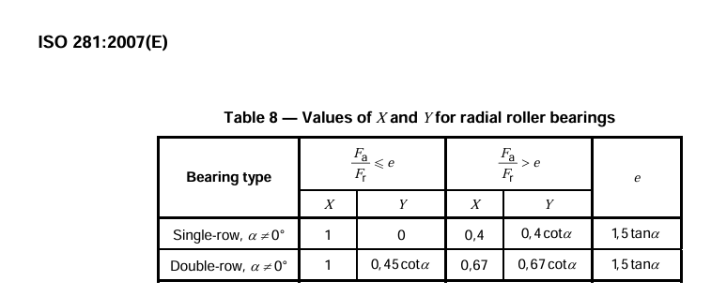
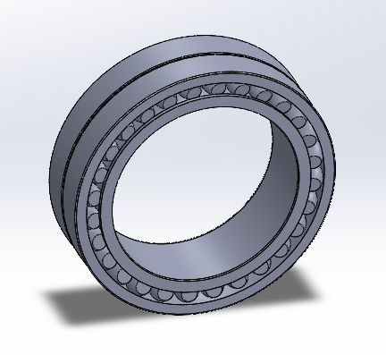
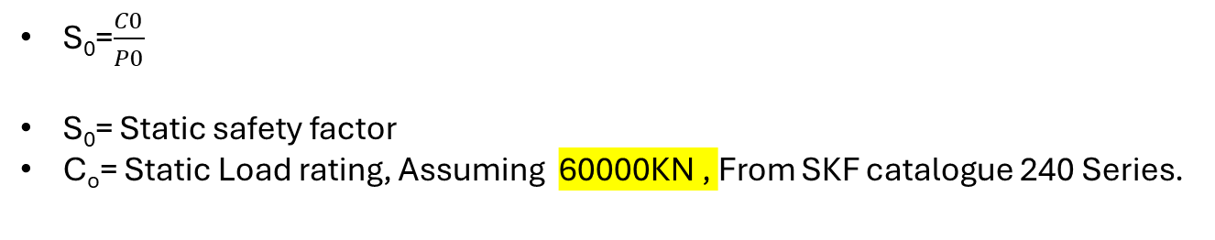
Static Safety Calculation of Bearing (Based on Assumption and scaling up factor)
P_{𝑜} = Equivalent static loading by releavant Load cases
P_{𝑜}=𝑋𝑜𝐹A𝑅𝑒𝑠𝑢𝑙𝑡𝑎𝑛𝑡+(𝑌𝑜∗𝐹𝑎,x)
From ISO 281 , X0=1
Y₀= 2.5 Assumed value from SKF catalogue of 240 series.
F_{a,x} =-F r,x = -1404.5KN
Fa,resultant = 9566.23KN
P0= 6054.98KN
S₀=$\frac{C0}{P0}$
S₀= Static safety factor
C_{o}= Static Load rating, Assuming 60000KN , From SKF catalogue 240 Series.
S₀=$\frac{60000 KN}{6054.98 kN}$ = 9.08 , which is very much greater than “2”,
Source: ISO 281:2007

Slide 8
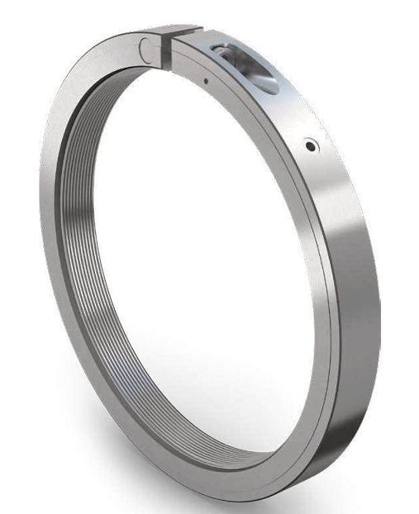
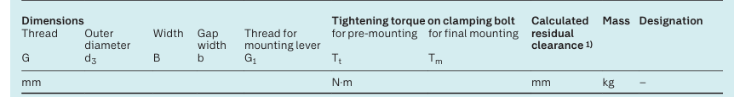
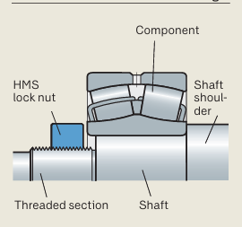
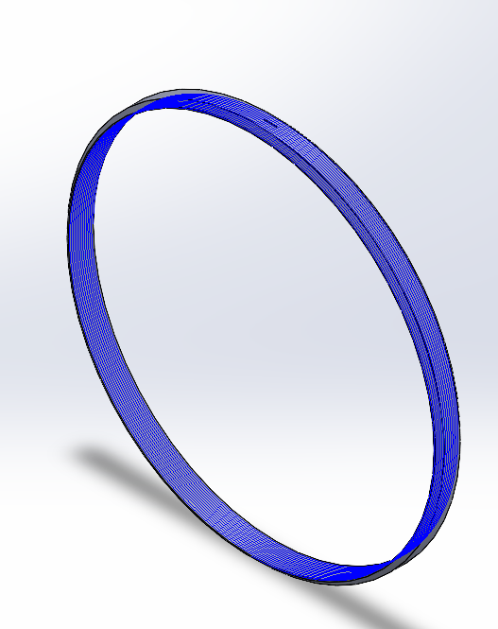
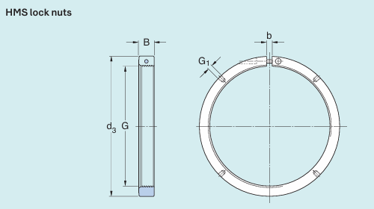
Lock nut
Assuming Tr 1600x 8 1650 110 40 M24
Source: SKF
Venkata Sreekanth .K

Slide 9
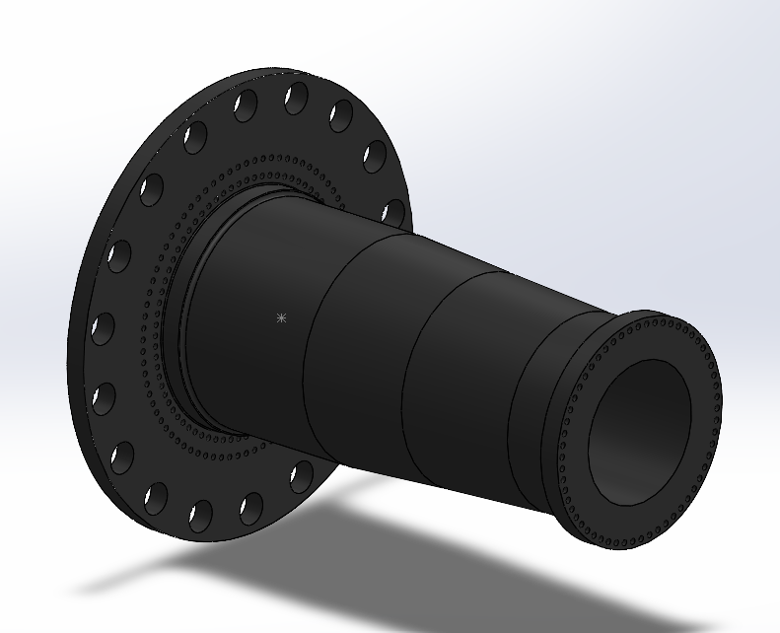
Rotor Shaft
Hub Side Flange
Description | Symbol | Value | Unit
Outer screw circle diameter | dt2 | 2040 | mm
Inner screw circle diameter | dt1 | 1800 | mm
No. of screws per bolt circle diameter | N_{total} = N_{ICB} + N_{OCB} | 75+85=160
Integrated rotorlock Flange outer dia | D_{flange} | 3190 | mm
Gear box Side Flange
Description | Symbol | Value | Unit
screw circle diameter | dt1 | 1500 | mm
No. of screws per bolt circle diameter | N_{total} | 58
Flange outer dia | D_{flange} | 1595 | mm
Venkata Sreekanth .K

Slide 10

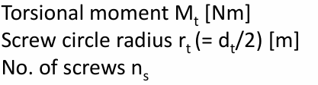


Force calculation on Bolts
At Gearbox flange
Shear force load on individual screw :
F_{q,mt}=$\frac{12800 KNm}{.750m∗58}$ = 294.25KN
At Rotor Hub flange
Shear force on screw by torsional moment M t
Source: Macninery components lectures and LLM(Large language models)
Venkata Sreekanth .K

Slide 11
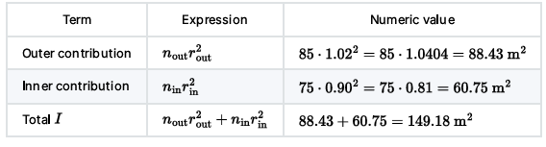
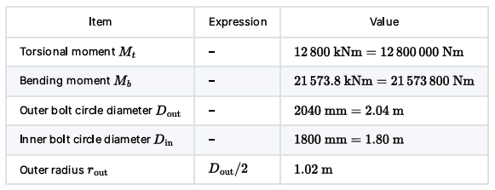
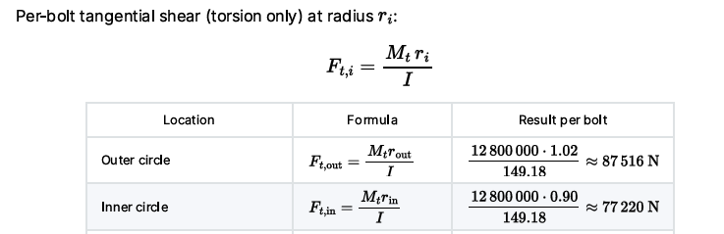
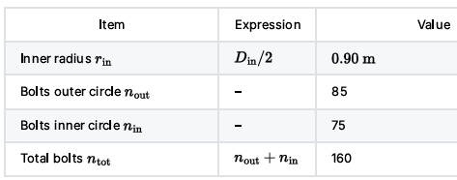
At Rotor Hub flange
Venkata Sreekanth .K
Source: Macninery components lectures and LLM(Large language models)

Slide 12
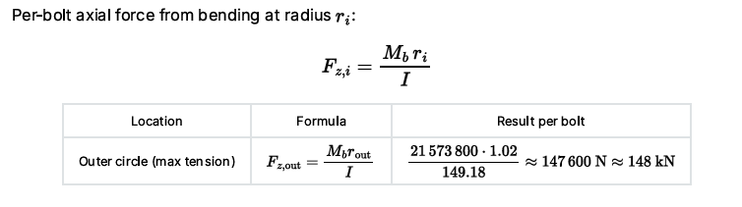

Venkata Sreekanth .K

Slide 13
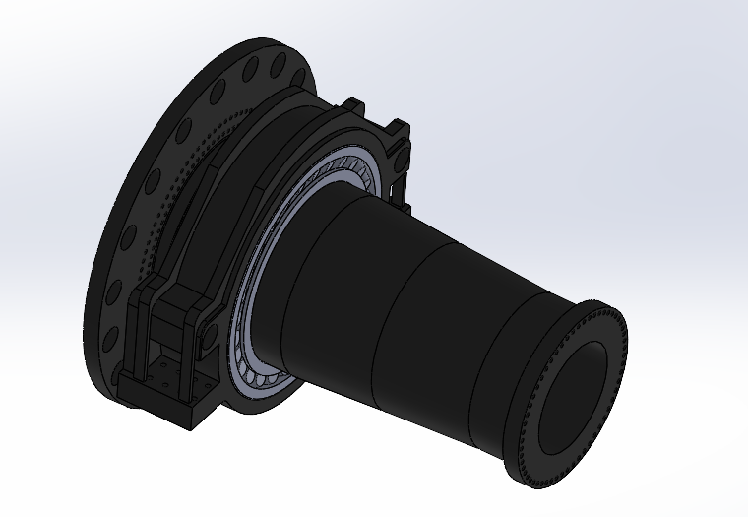
Rotor Bearing Assembly
Venkata Sreekanth .K

Slide 14
Cost Calculation(Assumption based on Mass)
Component | Mass (Kg) | Cost in USD (USD 10.00/Kg) | Cost in EUR (€ 8.60/Kg)
Main Bearing Housing | 7,422.54 | USD 74,225.40 | €63,854.63
Shaft | 33,162.20 | USD 331,622.00 | €285,287.77
TOTAL | 40,584.74 | USD 405,847.40 | €349,142.40
Finished Cost = Raw Material + Casting Cost + Machining Cost + Quality/Testing + Profit Margin
Venkata Sreekanth .K

Slide 15
Bibliography – Rotor Bearing System
SKF. (n.d.). 240/1120 CAF/W33 - Spherical roller bearings. Retrieved October 29, 2025, from https://www.skf.com/group/products/rolling-bearings/roller-bearings/spherical-roller-bearings/productid-240%2F1120 CAF%2FW33
Optimus Shakti, Optimus 60E
ITH. (n.d.). ITH Hydraulic Torque Wrenches Catalog. Retrieved November 08, 2025, from www.ITH.de/schraubwerkzeuge/hydraulische-drehmomentschrauber
DIN EN 10083-3: Steels for quenching and tempering – Part 3: Technical delivery conditions for alloy steels. Retrieved November 22, 2025, from https://studylib.net/doc/18166049/din-en-10083-steel-for-quenching-and-tempering-part-3-
American Institute of Steel Construction. (1989). Manual of Steel Construction: Allowable Stress Design (9th ed.). Chicago, IL: Author. Retrieved November 22, 2025, from Internet Archive (Manual of Steel Construction: Allowable Stress Design, 9th Edition)
International Organization for Standardization (ISO) (2007). ISO 281:2007: Rolling bearings — Dynamic load ratings and rating life. Retrieved December 1, 2025, from https://www.iso.org/standard/38102.html.
LLM(Large Language Models).
Venkata Sreekanth .K

